Slide 1
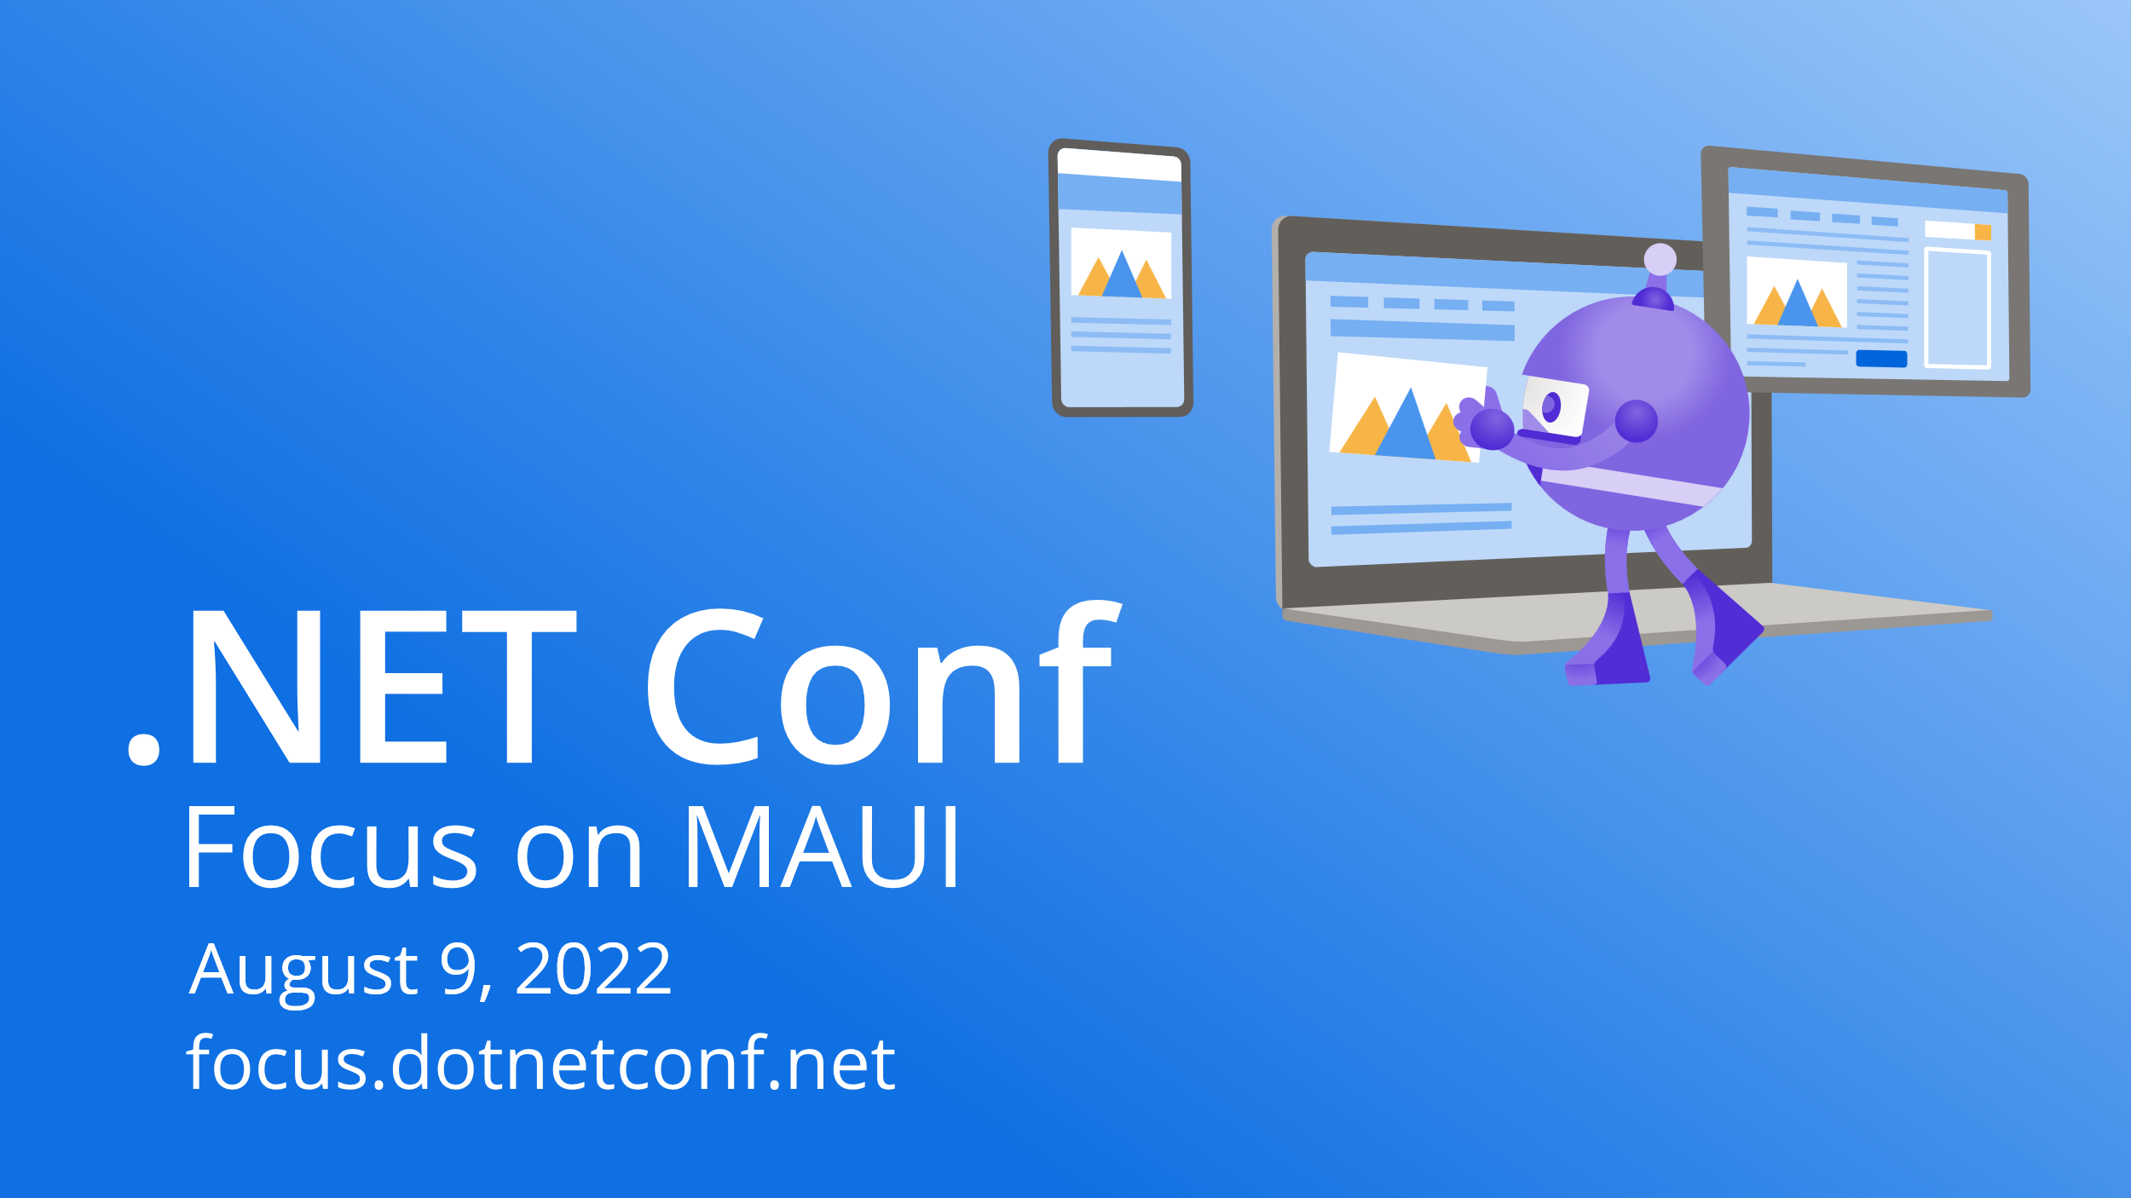

Slide 2


DevOps with .NET MAUI using GitHub Actions & Azure DevOps
Sweeky Satpathy
Senior Software Engineer

Slide 3

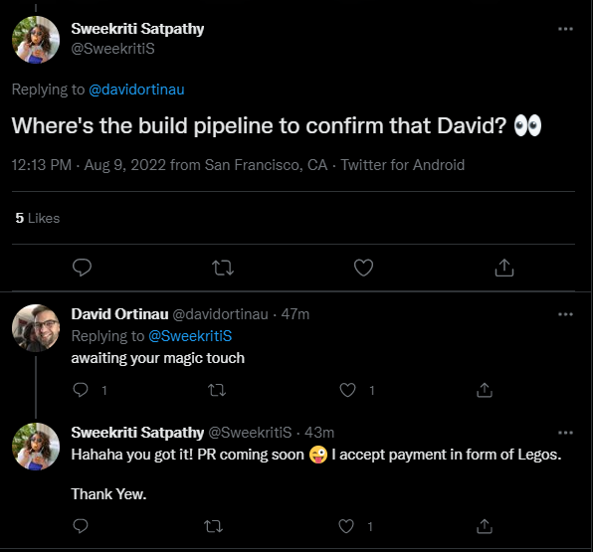
Let’s help David, help me get Legos.

Slide 4

Back to Basics

Slide 5

DevOps and .NET MAUI
✅ GitHub Actions
✅ Azure DevOps
✅ Run `dotnet build`on your local machine
✅`dotnet workload install`
✅ Visual Studio 2022 Preview for Windows
Notes:
https://azure.microsoft.com/en-us/services/devops/

Slide 6

Environment Setup
Installed Software on GitHub Actions VM : Available Environments
Installed Software on Azure DevOps VM : Available Environments
Self Hosting?
MacOS Setup Wiki
Windows : VS 2022 Public Preview

Slide 7

Secret Files
Guide Apple Signing
Guide Android Signing
Guide Windows Signing
GitHub Actions requires Encrypted secrets.
Apple Actions Tasks for Code Sign Cert and Provisioning

Slide 8
DevOps Pipeline!

Slide 9
Pipeline Overview
Set .NET Version
Install .NET MAUI Workloads
Install Signing Files (as needed)
Build/Publish App for TargetFramework
Upload Artifacts

Slide 10
Pipeline Overview
Set .NET Version
Install .NET MAUI Workloads
Install Signing Files (as needed)
Build/Publish App for TargetFramework
Run Unit Tests
Upload Artifacts

Slide 11

Demo :
WeatherTwentyOne DevOps

Slide 12

Let’s Test!

Slide 13
Run Unit Tests
## For NUnit Tests
dotnet build <path_to_test_csproj>
dotnet test --logger:"trx;logfilename=testResults.trx“
## Don’t Like Nunit? 😁
## Pick Your Player
✅ xUnit
✅ MSTest

Slide 14
Demo :
Unit Tests Run in DevOps

Slide 15
Report Test Results
GITHUB ACTIONS
AZURE DEVOPS
- name: Test Report
uses: dorny/test-reporter@v1
if: success() || failure()
with:
name: Service Tests
path: ~/TestResults/*.trx
reporter: dotnet-trx
- task: PublishTestResults@2
inputs:
testResultsFormat: 'VSTest'
testResultsFiles: '**/**/*.trx'
testRunTitle: 'Services Test'
condition: always()
Notes:
https://github.com/marketplace/actions/test-reporter
https://docs.microsoft.com/en-us/azure/devops/pipelines/tasks/test/publish-test-results?view=azure-devops&tabs=trx%2Cyaml

Slide 16
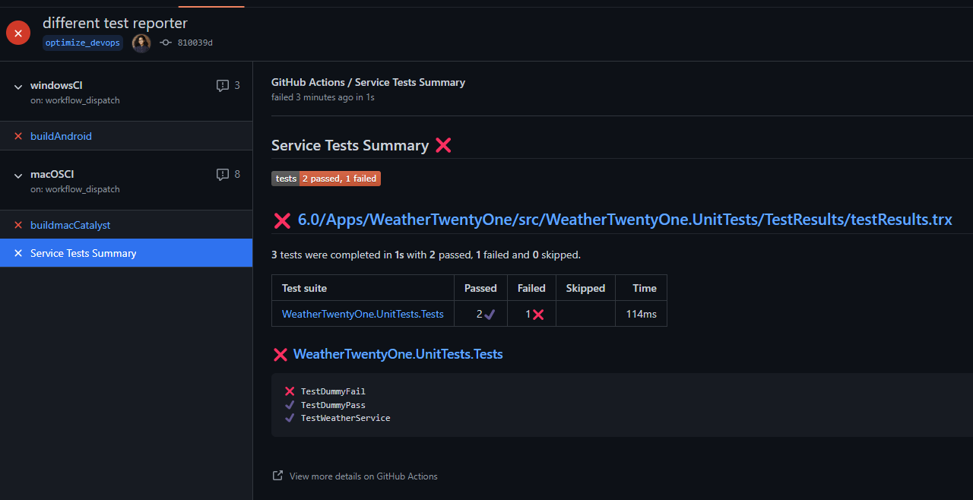
Run Unit Tests

Slide 17
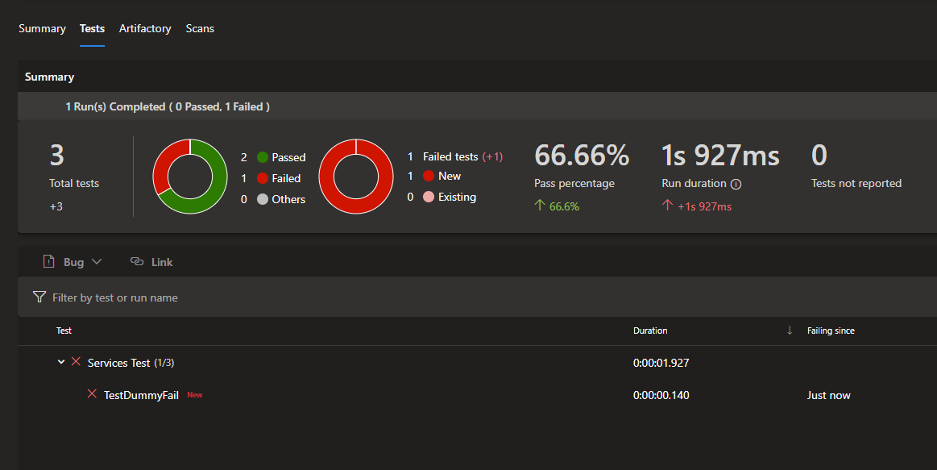
Run Unit Tests

Slide 18

Resources
Getting Started with DevOps and .NET MAUI Blog
What is Azure DevOps?
What is GitHub Actions?
GitHub Actions Test Reporter
Azure DevOps Publish Test Results

Slide 19

Thanks for joining!
Ask your questions live on Twitter #dotNETConf

